Slide 1
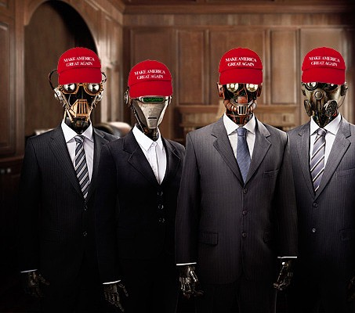
Did Donald Trump Use Artificial Intelligence to Win the Election?

Slide 2
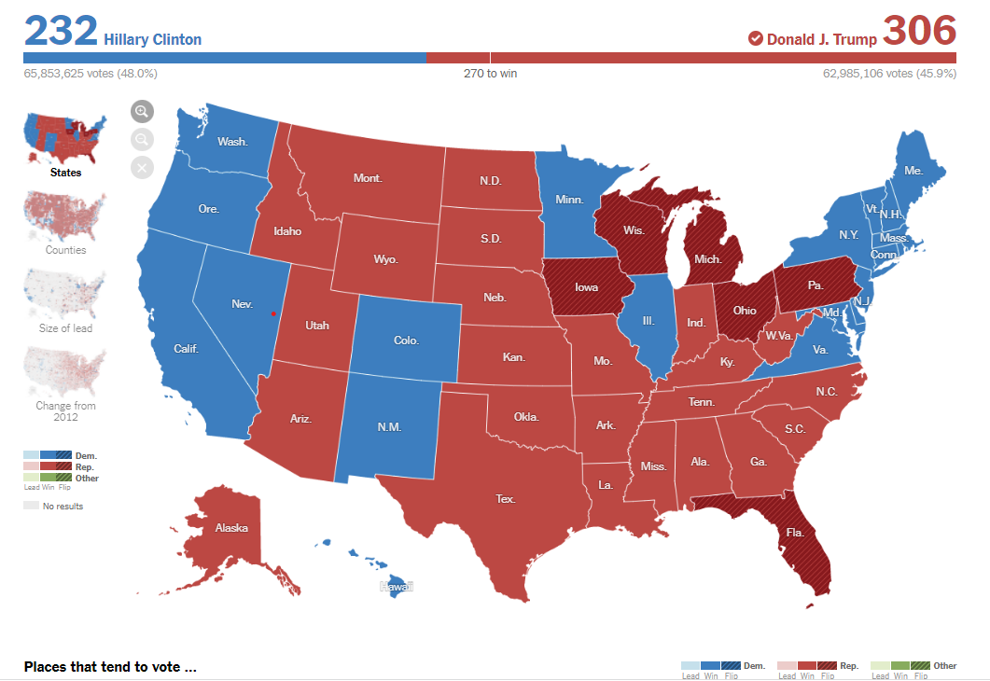
2016 Presidential Election Results

Slide 3
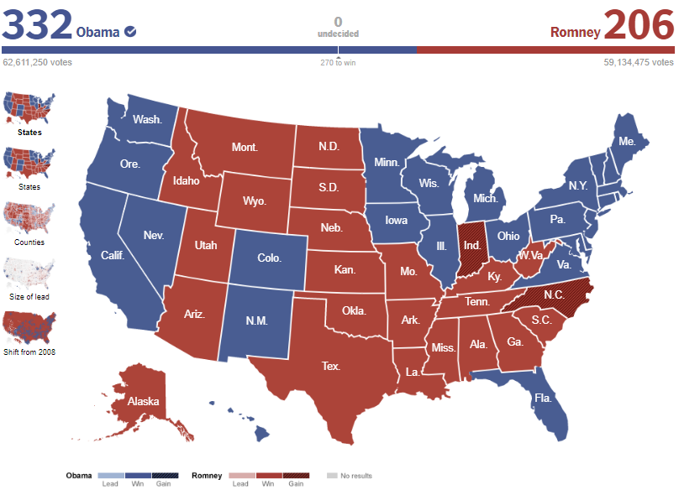
2012 2016

Slide 4
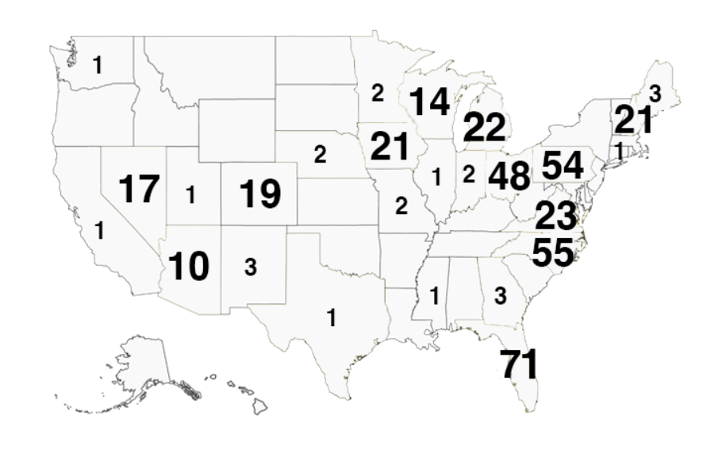
Data analytics to visit states

Slide 5
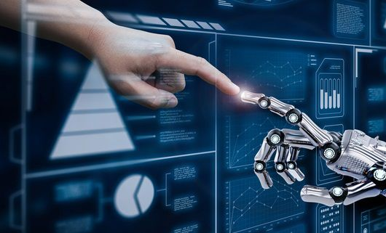
How did Trump win?
Artificial intelligence
Machine learning
Echo chambers
Botnet

Slide 6
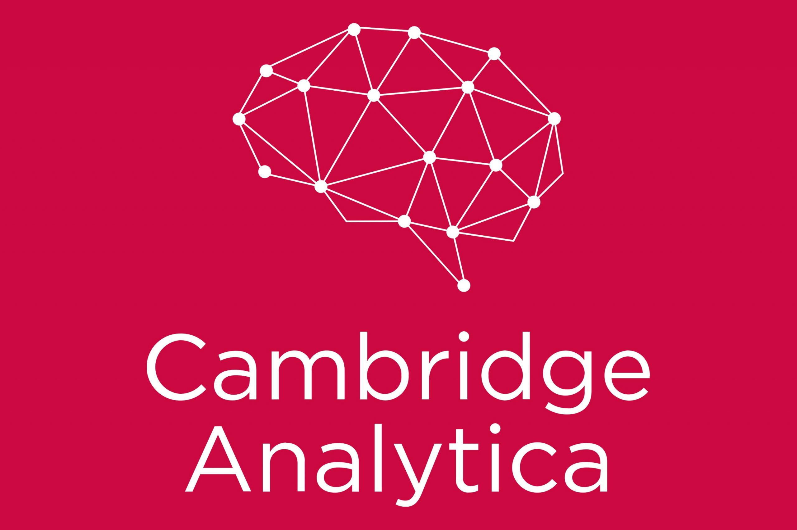
Trump alone?
Robert Mercer
1 ) ability to track and analyze everyone’s social media presence
2) target and optimize advertising
3) Using machine learning to show them “news” that matches their political identity

Slide 7
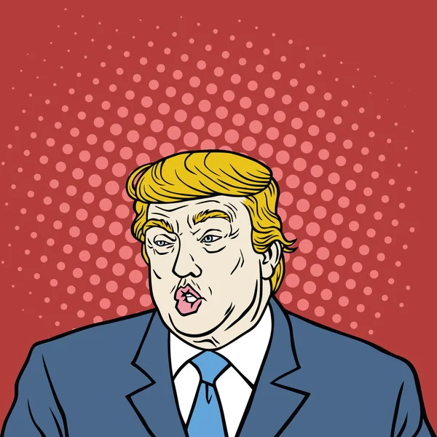
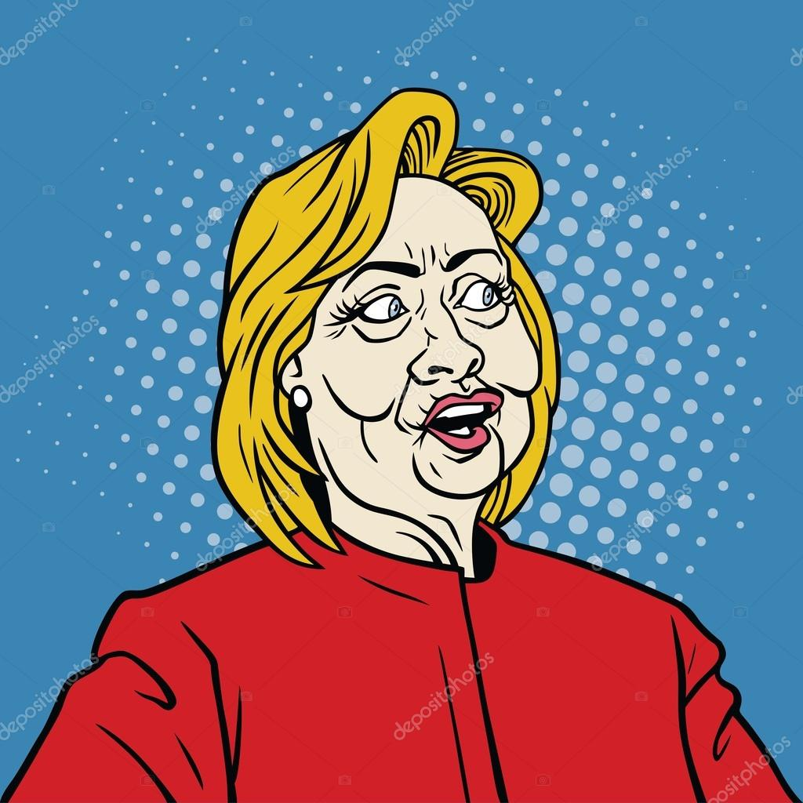
Identify potencial voter to persuade them
Poison voters to make them not vote
Persuade voters that were on the swing

Slide 8
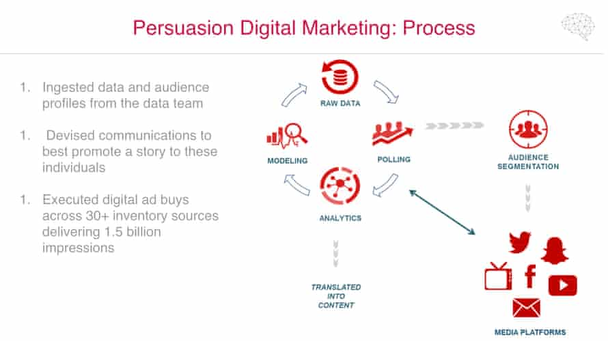
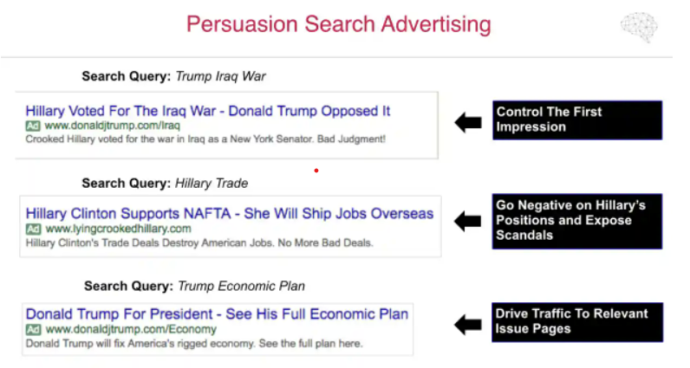
Purchased data and Facebook
- Project Alamo:
Giles-Parscale consultant firm.
demographics, interests, and affinities
- Global Science Research
Notes:
that collected profile information from 270,000 Facebook users and tens of millions of their friends using a personality test app called “thisisyourdigitallife.”

Slide 9
The SVD model- Singular Value Composition
Works much like the one Netflix uses to recommend movies.
Demographic data as race, age and gender.
Combine personal data with machine learning.
Demographics, social influences, personality and everything else into a big correlated lump
Essentially a set of inferred categories, ranked by importance
Notes:
For instance, the similar Kosinski-Stillwell-Graepel SVD model was 85 percent accurate in guessing party affiliation, even without using any profile information other than likes. Kogan’s model had similar or better accuracy. Adding even a small amount of information about friends or users’ demographics would likely boost this accuracy above 90 percent. Guesses about gender, race, sexual orientation and other characteristics would probably be more than 90 percent accurate too.

Slide 10
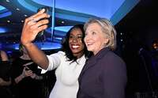
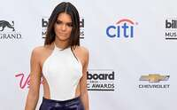
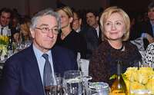
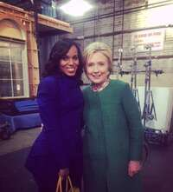
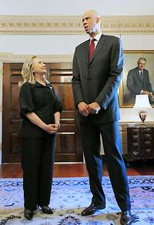

Accuracy and efficiency
Expensive and random

Slide 11

THE GREAT HACK
Do you find any ethical implications? Collateral effects?
How Cambridge Analytica
influence the Brexit?

Slide 12

Discussion
1) Do we need more complex propaganda to influence our behavior?
2) Is this an honest way to win an election?
3) Could this method extrapolate to larger conflicts?

